Slide 1
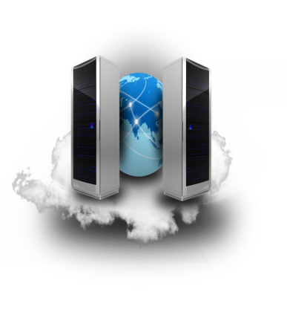
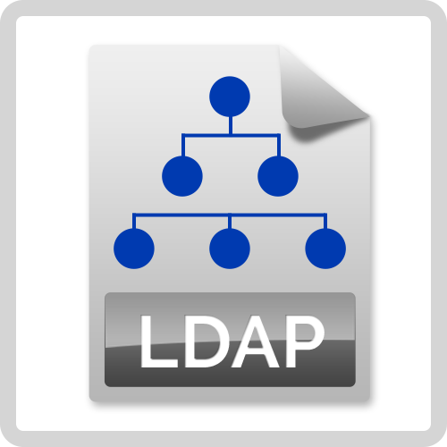
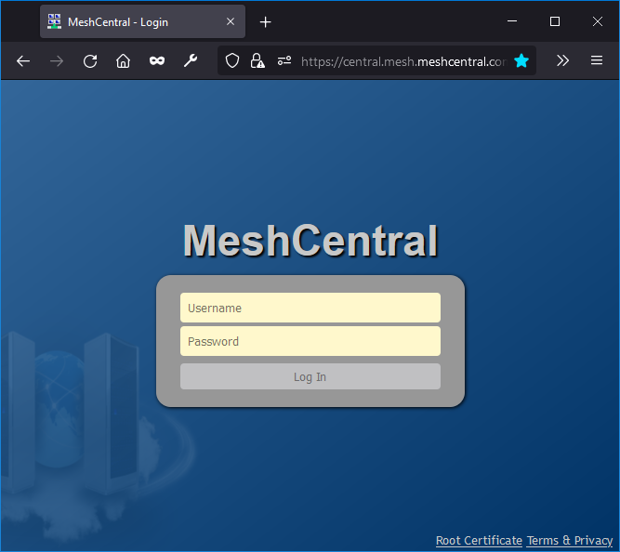
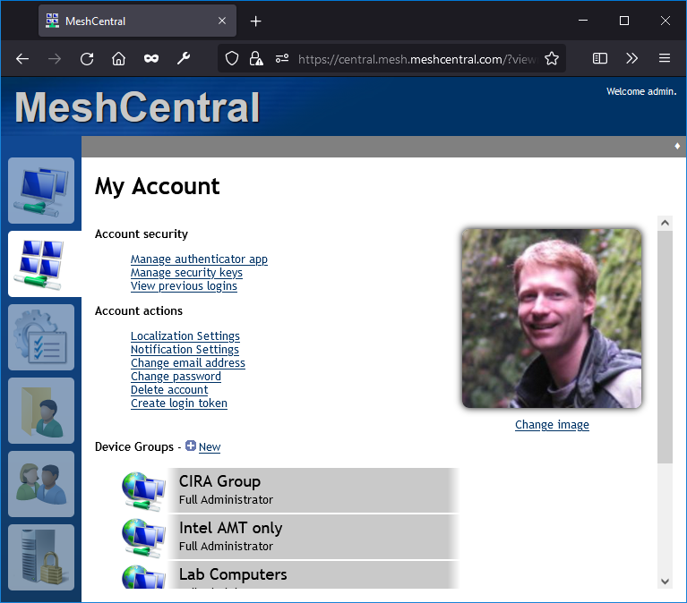
MeshCentral

Slide 2
Config.json
https://www.npmjs.com/package/ldapauth-fork
"domains": {
"": {
"auth": "ldap",
"ldapOptions": {
"url": "ldap://172.16.120.1:389/",
"bindDN": "cn=administrator,cn=users,dc=sample,dc=com",
"bindCredentials": “mypassowrd",
"searchBase": "cn=users,dc=sample,dc=com",
"searchFilter": "(name={{username}})"
},
"ldapUserKey": null,
"ldapUserBinaryKey": "objectSid",
"ldapUserName": "displayName",
"ldapUserEmail": "mail",
"ldapUserRealname": "name",
"ldapUserPhoneNumber": "telephoneNumber",
"ldapUserImage": "thumbnailPhoto", }
}

Slide 3
Config.json
"domains": {
"": {
"auth": "ldap",
"ldapOptions": {
"url": "ldap://172.16.120.1:389/",
"bindDN": "cn=administrator,cn=users,dc=sample,dc=com",
"bindCredentials": “mypassowrd",
"searchBase": "cn=users,dc=sample,dc=com",
"searchFilter": "(name={{username}})"
},
"ldapUserKey": "objectSid",
"ldapUserBinaryKey": "objectSid",
"ldapUserName": "{{{givenName}}} {{{sn}}}",
"ldapUserEmail": "mail",
"ldapUserRealname": "{{{givenName}}} {{{sn}}}",
"ldapUserPhoneNumber": "telephoneNumber",
"ldapUserImage": "thumbnailPhoto", }
}

